Slide 1
Entrepreneurship in Entertainment Technology
Welcome!

Slide 2
Today’s Agenda
CUSTOMERS

Slide 3
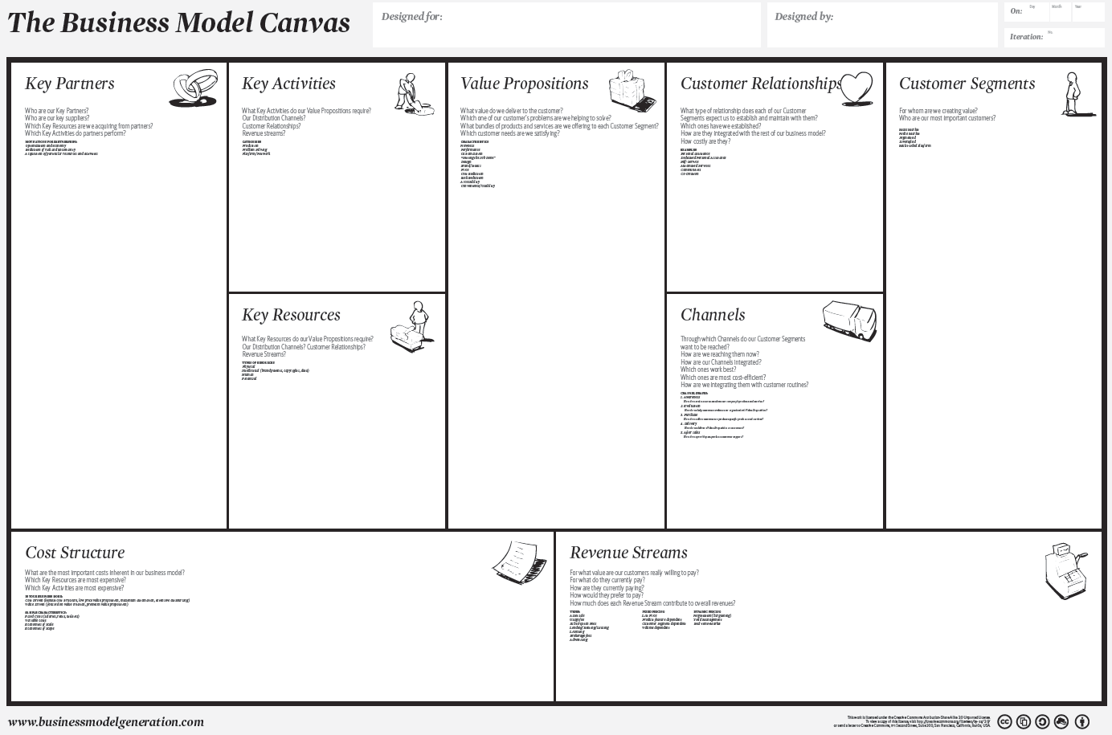
Notes:
So far we’ve covered a few parts of the BMC.
(Quick review)

Slide 4
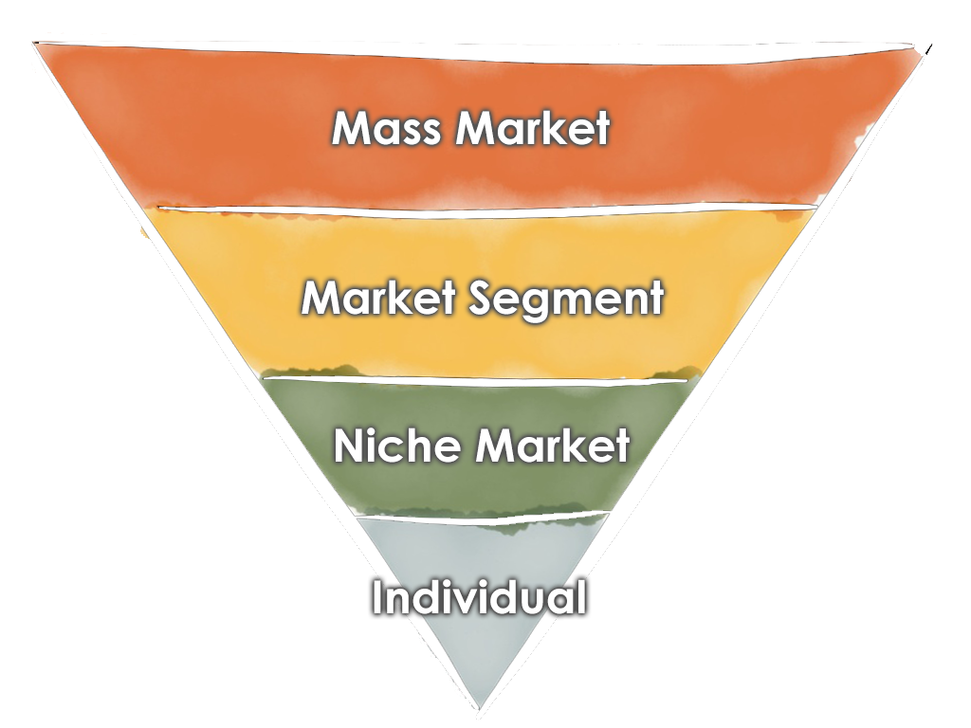
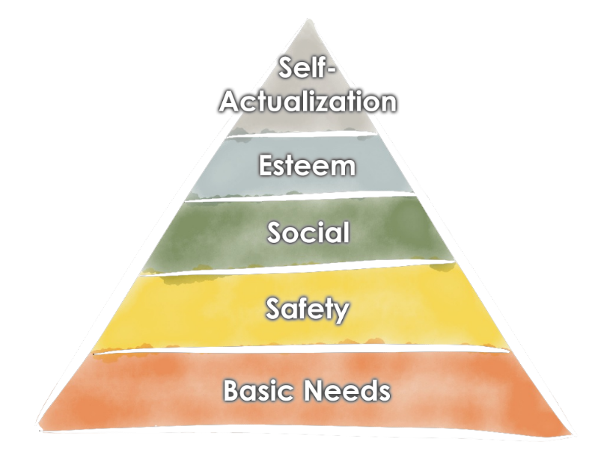
Notes:
Has been abstract: Niche, Segment, Mass; General human traits.
But they behave as individuals. Time to make that connection.

Slide 5
Notes:
How do we connect our Value Propositions to our Customers?
Relationship = how they interact with the company.
Channels = pathway through which that happens

Slide 6
Notes:
The important thing is that they are real people.
The “market” doesn’t buy your product, people do.
It’s individuals that make the decision. We need to convince each one of them to buy our product.

Slide 7
In class research
What’s the last product you bought?
Why that one instead of a competing one?
Notes:
Personal recommendations from reliable sources
Different VP = different customer: price, quality, convenience
Search
Ad = influence feelings and awareness
Customer relationship = e.g. brand loyalty or disloyalty
Awareness
Evaluation
Purchase and activation
Delivery
After Sales and Retention

Slide 8
In class research
What’s the last app you downloaded?
Why?
How did you find it?
Notes:
Personal recommendations from reliable sources
Different VP = different customer: price, quality, convenience
Search
Ad = influence feelings and awareness
Customer relationship = e.g. brand loyalty or disloyalty
Awareness
Evaluation
Purchase and activation
Delivery
After Sales and Retention

Slide 9
In class research
What company will you never buy a product from again?
Why?
Notes:
Personal recommendations from reliable sources
Different VP = different customer: price, quality, convenience
Search
Ad = influence feelings and awareness
Customer relationship = e.g. brand loyalty or disloyalty
Awareness
Evaluation
Purchase and activation
Delivery
After Sales and Retention

Slide 10
Notes:
Quick overview
Ties back in to the Business Model Canvas.
How do we connect our Value Propositions to our Customers?
They should be one thing
Relationship is the goal: the WHAT
Channel is the HOW, WHEN and WHERE
(Value Proposition is the WHY, Customers are the WHO)
The BMC handles these differently, I think they are intimately intertwined.
Personal assistance
Self-service
Automated services
Communities
Co-creation (reviews, uploaded content, other UGC)
Type of product or service will impact this greatly
Service company
Product company
Experience company

Slide 11
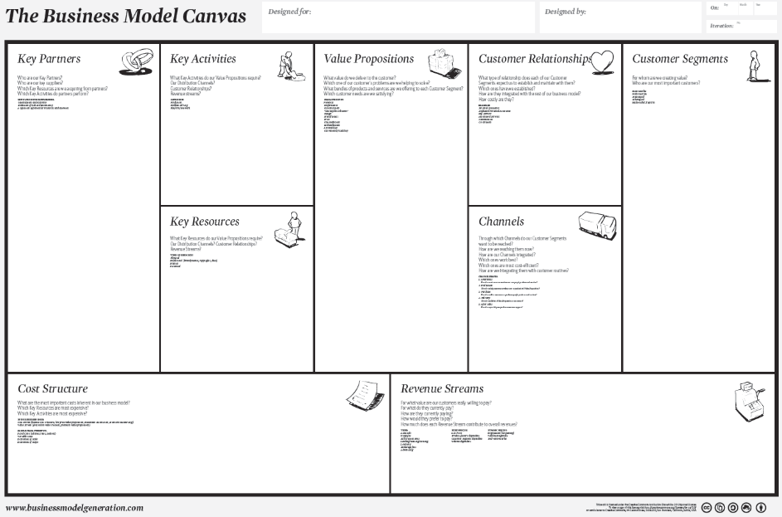
Notes:
Quick overview
Ties back in to the Business Model Canvas.
How do we connect our Value Propositions to our Customers?
They should be one thing
Relationship is the goal: the WHAT
Channel is the HOW, WHEN and WHERE
(Value Proposition is the WHY, Customers are the WHO)
The BMC handles these differently, I think they are intimately intertwined.
Personal assistance
Self-service
Automated services
Communities
Co-creation (reviews, uploaded content, other UGC)
Type of product or service will impact this greatly
Service company
Product company
Experience company

Slide 12
Customer Phases
Awareness
Evaluation
Purchase
Delivery
After Sales

Slide 13
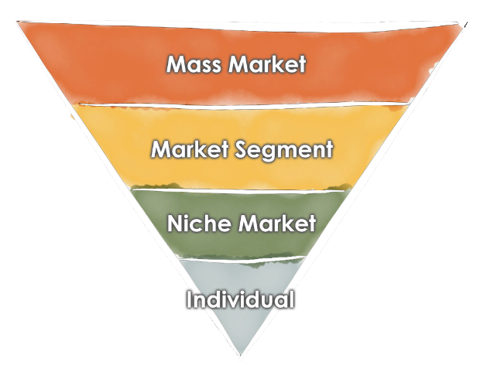
Customer Phases
Awareness
Notes:
Initially: get a small base of active users (PDI, facebook, class examples…)
Start building awareness immediately
Niche group with direct communications
Examples at different scales (Word of Mouth vs. Superbowl Ads)
Word of mouth, reviews, blogs, articles, endorsements
Put your face out there – speaking, interviews, conferences
Be an expert

Slide 14
Customer Phases
Awareness
Evaluation
Notes:
Customers want to minimize risk.
Trying the product is the best way to get comfortable with decision to purchase.
Retail stores still exist because of this (ice cream, cars, wine, shoes, clothes, movie trailers, puppies, books)
Online has to compete – Amazon (preview), Zappos (return), free shipping
Kickstarter is all about evaluation
Freemium (Zynga)
Trial Periods (Netflix, Kindle 7 days)
Free samples (ice cream, CostCo, Kindle first chapter)
Free examples (movie trailers)
Play with puppies
Reduce risk
Easy to return
Trial period/subscription
Free shipping

Slide 15
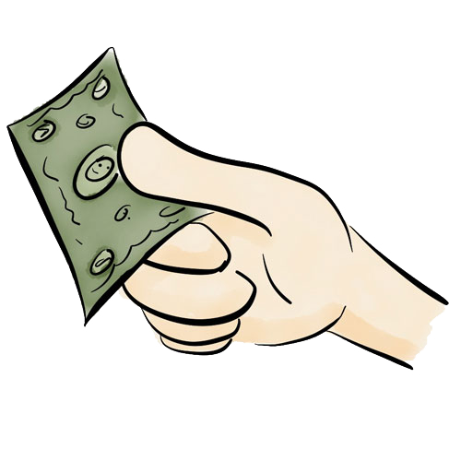
Customer Phases
Awareness
Evaluation
Purchase
Notes:
Make it easy for people to give you their money!
Shopping carts get abandoned from friction
Grocery stores: add a checker, self checkout
Sunglass store example: “Back in ½ an hour”
Amazon “one click”; Apple store
Tie evaluation to purchase (automatic sale)
Apple and Android Pay
Square

Slide 16
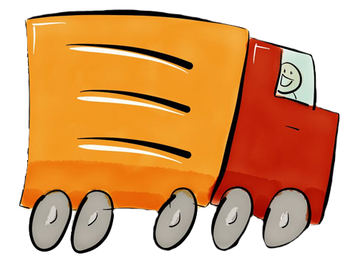
Customer Phases
Awareness
Evaluation
Purchase
Delivery
Notes:
For some things, the delivery IS the product. Anything experiential – Disneyland, vacations, movies…
Delivery:
- Retail is easy for the customer, just walk out with it.
Online has to master shipping. (Amazon, Zappos, Netflix)
Digital delivery (should be) easy. DRM gets in the way. Origin gets in the way. Pirating is easier.
This is a great time to WOW! the customer. (PDI’s video tapes, Amazon drones(!), Uber…)
Examples of great delivery:
Unboxing
Boxed products
Board Game happiness
Burrito drone
Tesla
https://www.youtube.com/watch?v=Tucad2-i08U
Kickstarter.com

Slide 17
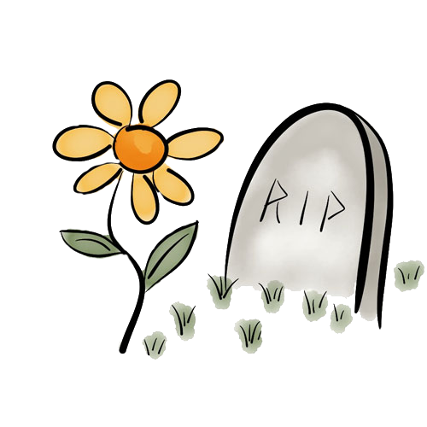
Customer Phases
Awareness
Evaluation
Purchase
Delivery
After Sales
Notes:
No one buys something only once. (Class exercise)
You want them to come back. How you treat them after is just as important as before.
Costs less to keep a customer than get a new one (we’ll see that later in Financial section).
Referrals are crucial. Help them with it.
Bad reviews are easy and common – turn it into an okay experience for them, or even win them back.

Slide 18
Customer Phases
Awareness
Evaluation
Purchase
Delivery
After Sales/Retention
Notes:
Quick summary
How do we know if our plans are working?

Slide 19
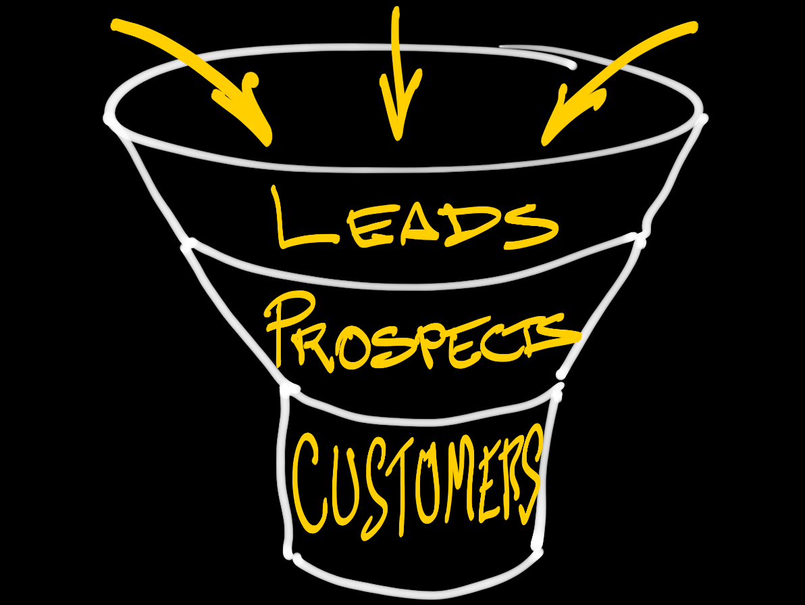
Sales Funnel

Slide 20
Metrics
Notes:
How we measure our status, evaluate progress.

Slide 21
metrics
Customer acquisition cost (CAC)
Lifetime customer value (LCV)
LCV/CAC
Churn
Referral value
Notes:
Small number of meaningful measurements.
Metrics. From your financial model you should have some ideas about what drives people to your product and how you convert them, or what it costs to get a customer. How can you measure this? You need some way to measure how effective your marketing dollar or effort is. What do you do if you aren’t hitting your metric? (eg. conversions…)
Customer acquisition cost = Marketing costs / new customers
Conversion rate = New customers / evaluators
Lifetime customer value = Revenue per customer per unit time * timespan of customer
Churn
Referrals

Slide 22
Some advice

Slide 23
focus
DOMINATE
a small market first.

Slide 24
10x growth strategy
10 customers
100 customers
1,000 customers
10,000 customers
…

Slide 25
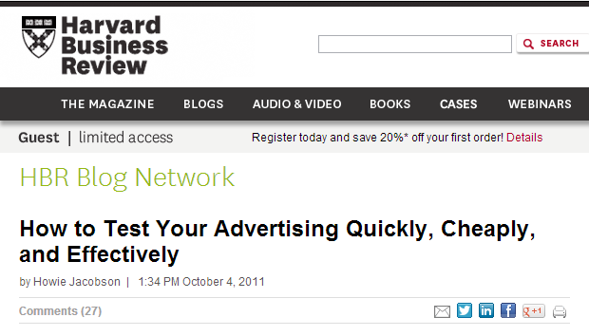
example
Notes:
Using search data to develop a marketing strategy http://blogs.hbr.org/cs/2011/10/the_fastest_cheapest_best_way.html
1. The 4-Hour Work Week vs. Broadband and White Sand
3. Mars, Inc. invests pennies to earn millions In 2009 Vitruvian's Joel McDonald was hired to manage a $1000/month AdWords account for a division of Mars, Incorporated. Keep in mind that Mars' advertising budget for 2009 was estimated by Advertising Age at $1.6 billion. But the investment paid off handsomely once Joel harvested their AdWords data and had them apply it to their advertising in "unmeasurable" media.
Joel ran keyword tests to discover the most searched-for ingredients in this product line. Through ad testing, he found "free shipping" generated nearly twice the sales of the original "30% off" offer (specifics have been changed for confidentiality reasons.)
Within about a month of reporting his AdWords tests, Joel saw a virtually identical product description, price, and offer on Mars' national TV commercials. Now a miniscule AdWords investment was paying huge dividends in other media. Mars no longer had to depend on the creative impulses of expensive Madison Avenue ad writers. They just applied common sense to AdWords data and cloned tiny successes on a massive scale.

Slide 26
Next Class

Slide 27
Presentations
7 Minutes
Talk to potential users; present results
Present your customer plan
Who is your customer?
Awareness, Evaluation, Purchase and Activation, Delivery, After Sales?

Slide 28
Whiteboarding
What do your customers want? (Not what are you selling them)
How are you going to attract your core audience?
Notes:
(Didn’t use in class)

