Slide 2
Entrepreneurship in Entertainment Technology
Welcome!

Slide 3
Startup Process
Ideas
Business Models
Market Research
Next Class

Slide 5
Presentations Preview
Your “Final” Idea
Value Proposition
Customers
Market Opportunity
Competition

Slide 6
Startup Process
Notes:
Change this to be the five stages rather than four steps.
Awareness, Evaluation, Purchase, Delivery, After
Works the same for a product or a company

Slide 7
Idea

Slide 8
Idea
Research

Slide 9
Idea
Research and Modeling

Slide 10
Idea
Research and Modeling
ITERATE!

Slide 11
Idea
Research and Modeling
Execution

Slide 12
Idea
Research and Modeling
Execution
PIVOT!

Slide 13
Idea
Research and Modeling

Slide 14
Idea
Research and Modeling
Execution

Slide 15
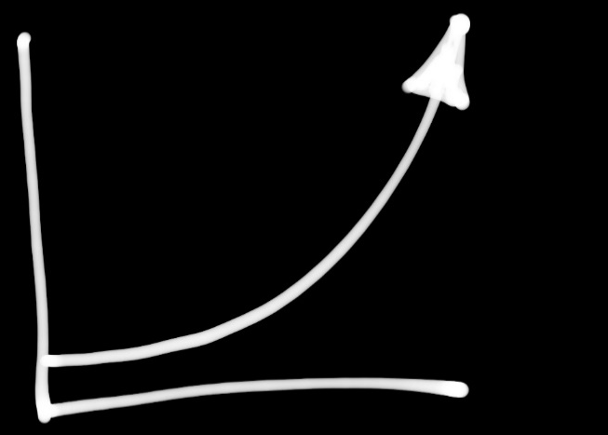
Idea
Research and Modeling
Execution
Growth

Slide 16
Idea
Research and Modeling
Execution
Growth
Exit

Slide 17
Idea
Research and Modeling
Execution
Growth
Exit

Slide 18
Business model canvas
Notes:
http://steveblank.com/2010/11/15/creating-startup-success-customer-development-business-model-design/
Presentation by Alexander Osterwalder
Setup: watch the slide show, then discuss. Also, pay attention to how awesome the slides are.
Walk through 9 building blocks twice (slide 36+). Once with Zynga, once with DWA. Have students explain each piece
Numerous business models (slide 55). Use Angry Birds as an example with advertising (Android) vs. sales (iPhone) (slide 58).
Also many different models for the publishing a book (Business Model Generation, p. 166)

Slide 19
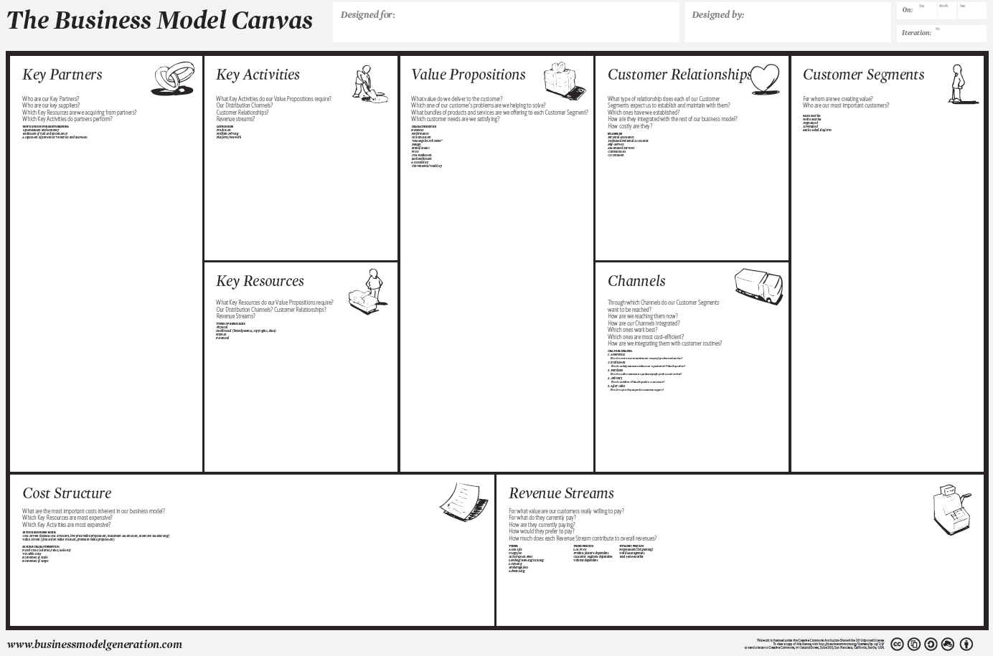
Notes:
Today.
Over the next three weeks we’ll be digging deeper into the whole model.

Slide 20
Notes:
Why we want to evaluate our ideas
Market need: who is your customer
Value proposition: why the customer chooses your product over that of your competitors or other solutions. A concise definition of the unique benefits your product offers. Why they part with time or money to use your product.
Business opportunity: can you monetize it?

Slide 21
Where do ideas come from?
Notes:
Ask the room about their presentation ideas.
“out of the blue”
“I had a problem/need”
“I had a solution” (but what’s the problem?)
Tons of research and brainstorming
The point: they can come from anywhere. They might be intentional and the result of a lot of work, or they might seem to pop up out of nowhere.

Slide 22
Valuing ideas
Notes:
But which ideas are worth building a company around?

Slide 23
“There is no market for ideas.”
- Tim Ferriss
Notes:
If ideas had value there would be a market for them.
See ‘Trust Me, Your Idea is Worthless’ by Tim Ferriss in Do More Faster

Slide 24
Share Your Ideas!
Notes:
There are probably three other people working on your same idea right now. Investors don’t care who came up with the idea first, they’re interested in investing in the team that has the best chance of delivering the product. The same holds for attracting partners, employees and customers – everyone wants to work with the person who can execute on the idea.
Don’t be afraid to share your ideas – the chance of someone ripping you off and doing it faster and better is slim. If you share your ideas you will receive valuable feedback for improvement, you will engage others in your vision, and you will even inspire a few to join you on your journey. All of that will give you a better edge.

Slide 25
First ideas
podcast store
feature in a game
live stream of Justin Kan’s life
internal messaging for game dev team
internal chat service for game dev team
Notes:
The idea you launch with probably won’t be the idea the company launches with
Add Facebook, Valve, Google
Flickr: “Game Neverending” MMO
Butterfield -> Tiny Speck to make “Glitch” MMO, Slack was their internal IRC
http://www.fastcompany.com/3026418/open-company/this-story-about-slacks-founder-says-everything-you-need-to-know-about-him (Stewart Butterfield, who with Caterina Fake started Flickr)
While working on developing a free-to-play iPad game, Fates Forever, Jason encountered numerous issues with the existing VoIP options. To overcome these, he started working on a chat service that could provide a secure voice and text messaging service for his internal team. This was the beginning of the chat app for multiplayer mobile gamers, or, Discord. When Jason’s team failed to monetize the much-anticipated Fates Forever game, released in 2014, they persisted with Discord. Soon, they decided to market Discord as a free voice and text chat application for gamers who want to talk to team members during a game.

Slide 27
Idea

Slide 28
Idea
Research and Modeling
Notes:
Research here = evaluating your idea(s) in the context of building a business around it
Research feeds into the Model and iterates with it.
Does my VALUE PROPOSITION have value?
Time to test it!
What is the MARKET OPPORTUNITY?

Slide 29
Value Proposition
Notes:
Why customers would use your product rather than some other solution (or none at all)
Customers define the value of my idea.

Slide 30
“People don’t want to buy a quarter inch drill.
They want a quarter inch hole.”
- Theodore Levitt
Notes:
Don’t think in terms of your product (idea), think in terms of what the customer wants.

Slide 31
Value Proposition
ADDITIVE
CREATE or ADD VALUE
SUBTRACTIVE
REDUCE PAIN
Notes:
Subtractive (bottom of Maslow): game engines (tools), gmail, insurance
Additive (top of Maslow): entertainment, social apps, iPhone & google (instant access to information)

Slide 32
Additive or Subtractive?
Notes:
Team ideas that were pitched on Tuesday.
If the idea is additive, does it create value or add value?

Slide 33
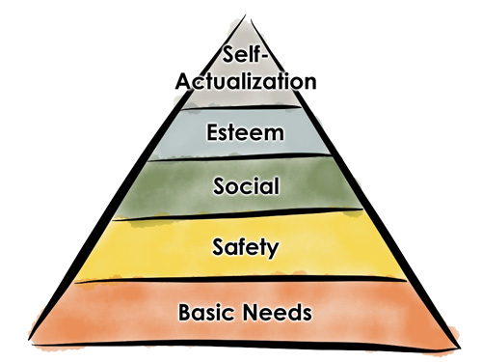
Maslow’s hierarchy of needs
Notes:
Subtractive on the bottom, additive on the top.

Slide 34
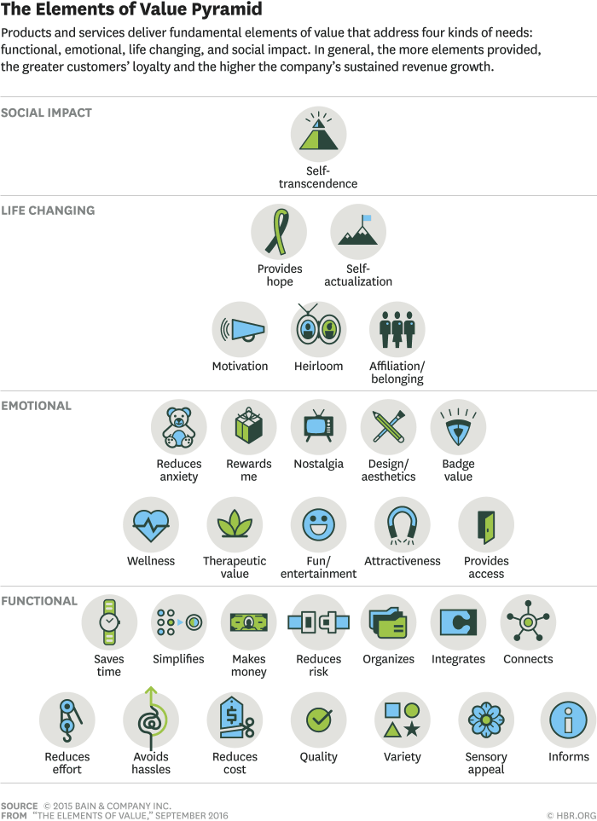
Elements of Value
Social Impact
Life Changing
Emotional
Functional
Notes:
Subtractive on the bottom, additive on the top (mostly)

Slide 35
Evaluation tools
ADDITIVE
SUBTRACTIVE
Notes:
Lots of ways to evaluate ideas, this is only three of them.
Models like this help to frame ideas and give a basis for examining them.

Slide 36
Value Proposition Examples
Photo Sharing Apps
Music Apps
Payment Apps
Phone OS
Notes:
Class brainstorm on favorite products. (Instagram, Spotify, Unity, Adobe, Venmo)
How companies differentiate themselves: iOS vs. Android, Vimeo vs. youtube

Slide 37
Business Model Hypothesis
Value Proposition +
Market Opportunity +
Customers
Notes:
The MARKET is the full set of all possible customers.
The MARKET OPPORTUNITY is a quantified description of that market – potential revenue, number of customers, units sold…
Step 1 brings us to our tool…

Slide 38
Market Opportunity
Notes:
A quantified description of the market:
Revenue
Number of customers
Units sold

Slide 39
Evaluating Market Opportunities
Market Type
Market Size
Competition
Customers

Slide 40
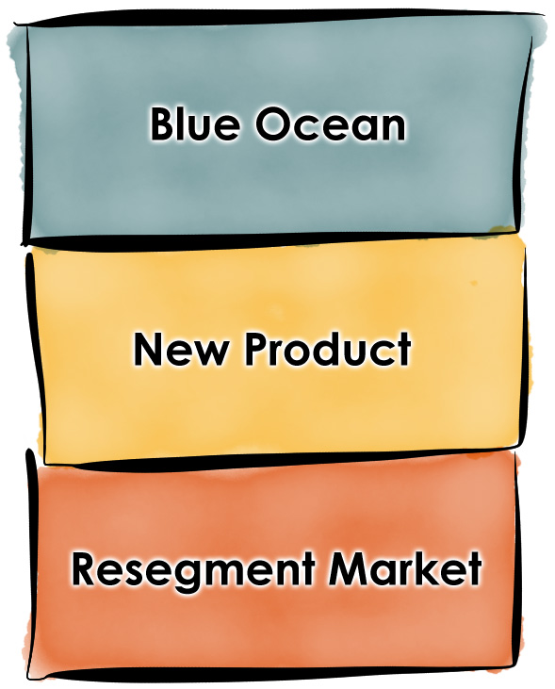
Market type
Notes:
Market types:
Creating a new market (“Blue Ocean”)
Bring a new product to an existing market (“better” product)
Resegment an existing market (by price or niche)
Price: Cheaper or more expensive
Niche: specialized markets

Slide 41
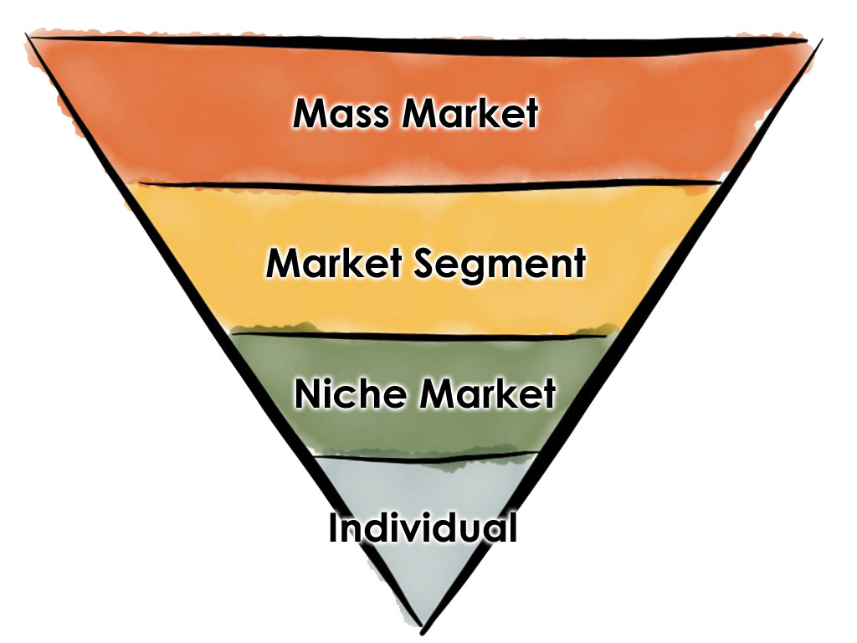
Market Size
Notes:
MASS: highly inclusive for similar products. Cars, strawberries, banking, entertainment, search…
SEGMENT: differentiated sets of needs for similar products. Yes: cars, banking, search (travel, ancestry…). No: strawberries
NICHE: special or focused needs. Classic cars, brand enthusiasts. Strawberries (local organic). Search (patents, medical)
INDIVIDUAL: custom one-off work (custom car, personal ancestry search, home garden)
Entertainment has genres for segments and niches.
Talk about game and movie areas.
“Cameo” hire a celebrity

Slide 42
Market size?
Notes:
Team ideas that were pitched on Tuesday.
How would you find the market size?
Customers
$

Slide 43
Competition
Direct and Indirect
Notes:
Direct = similar products and/or market
e.g. For a movie – other movies released at the same time
For a game – other games in the same genre, compete on style, game play, cost, etc.
Indirect = competing for customers time/attention/money
e.g. For a movie – all other social gatherings are competition
For a game – all other forms of entertainment

Slide 44
customers
You don’t know anything until you talk to real people!
Notes:
Next week!

Slide 45
sUMMARY
Startup Process
Ideas
Evaluation
(research and model)
Notes:
Summary of what we covered today.
Now your turn to apply it.

Slide 46
Next Class

Slide 47
Homework
Presentation survey due Friday
Prepare Tuesday presentation

Slide 48
Presentations
Research your ideas, dig deep into one of them.
From the Business Model Canvas – your “Market Model”:
Value Proposition
Customer Segments
Revenue Streams
Market Opportunity
Estimate the market size for your product
Dollars
Customers
Direct and Indirect Competition

Slide 49
Presentations
Choose One Idea
Value Proposition
Market Opportunity
Revenue Streams
Competition

Slide 50
Value Proposition
(additive or subtractive?)
(why do they need it?)
(why is it better than their current solution?)

Slide 51
Market Opportunity
Estimate the Market Size
Who are your customers?
How many of them are there?
Initial niche?
Biggest market?
How big is the market in dollars?

Slide 52
Revenue streams
(keep it general for now)
Possible revenue models
How much might a customer pay?

Slide 53
Competition
Direct
Indirect

Slide 54
Presentations
7 minutes
Audience is us

Slide 55
Resources

Slide 56
Resources
Pages 1-60 in “Do More Faster” – Theme 1: Idea and Vision
Slide presentation:
steveblank.com/2010/11/15/creating-startup-success-customer-development-business-model-design/
Book – “Business Model Generation”
www.businessmodelgeneration.com/
www.businessmodelgeneration.com/downloads/business_model_canvas_poster.pdf
www.businessmodelgeneration.com/downloads/businessmodelgeneration_preview.pdf
Notes:
Pages 1-60 in “Do More Faster” – Theme 1: Idea and Vision
Slide presentation:
steveblank.com/2010/11/15/creating-startup-success-customer-development-business-model-design/
Book – “Business Model Generation”
www.businessmodelgeneration.com/
www.businessmodelgeneration.com/downloads/business_model_canvas_poster.pdf
www.businessmodelgeneration.com/downloads/businessmodelgeneration_preview.pdf

Slide 57
More Resources
Value Proposition – Christina Wodtke https://medium.com/the-creative-founder/ideation-sprints-for-new-products-services-74f925190b4f

