Slide 1
Entrepreneurship in Entertainment Technology
Welcome!

Slide 2
Class Overview
Carl Rosendahl
carlr@andrew.cmu.edu
(650) 867-6727
eet.etc.cmu.edu
Office Hours:
bit.ly/crosendahl
Notes:
My goal is to introduce you to the full gamut of being an entrepreneur and starting a company. Expose you to wide range and build vocabulary. Teach you how to find more info.
Can’t teach you to be an entrepreneur, can’t teach you a full MBA in this class, but I can teach you how what information you need, how to find it, and how to learn it.
Office hours bit.ly/crosendahl

Slide 3
Today’s Agenda
You
Me
The Class
More You
Resources
Next Class
Notes:
Review syllabus: make sure we’re covering what you want to learn

Slide 4
you
Notes:
We’re going to share a lot with each other this semester. Lots of discussions, lots of opinions. We’ll all be doing presentations, as teams and individually. We’ll be open and honest, but polite and respectful. We’ll bond pretty close.
Self introductions
Name
Something outside of school that you know a lot about
Location & timezone
Available tech

Slide 5
What to you hope to get out of EET?
Notes:
https://forms.gle/VUPtKsTxoEnNo59z7
Bring up results and discuss.
Next, we’re going to go through the syllabus. As we do, we’ll see if we’re going to satisfy what you want from the class. If not, then we’ll change the class around a bit.

Slide 9
Course Description
Notes:
Overview of entrepreneurship and innovation
Entrepreneurial frame of mind
Framework for ideas to launched product
Work in teams
Knowledge will be applicable to any job you have, AND personal life

Slide 10
Objectives
Understand the process for starting a company
Research and evaluate market opportunities
Develop a basic financial model and plan
Devise a basic marketing/sales plan
Evaluate and select an appropriate corporate structure
Identify appropriate sources for funding
Present ideas clearly and concisely, casually or formally
Assess your role in a start-up
Notes:
So. Many. Words.

Slide 11
Organization
Explore through stages
Founding teams
Thursdays:
Lectures and discussions
Tuesdays:
Presentations and discussions
Notes:
How the semester is organized. Next slide is the stages.

Slide 12
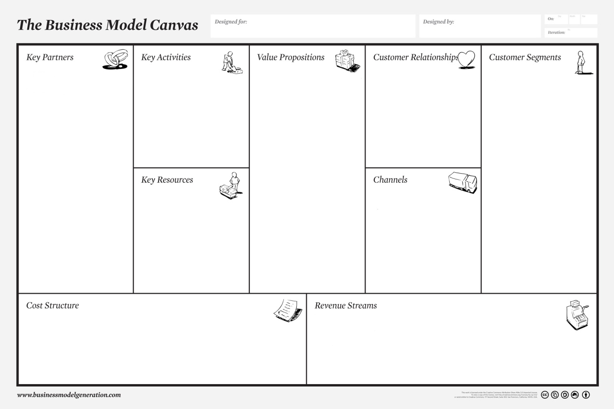
Classes
Startup Basics
Culture and Values
Real World Examples
Practical Issues
Long Term
Final Presentations
Notes:
When reviewing classes, check off what people wanted from the class. If something is missing, add it.

Slide 13
Schedule

Slide 14
Example presentation
Notes:
The FlixMaster presentation is at http://techstars.wistia.com/medias/85d6e9a1be
http://www.raptmedia.com

Slide 15
Materials
Presentations
Resources

Slide 16
Requirements
Attendance
Participation
Preparation
Presentations

Slide 17
Evaluation / Grading
Comprehension 40%
Participation 20%
Presentation 20%
Attendance 20 - 40%

Slide 18
Policies
Notes:
Behavior
Participation
Devices and Recording
Communications
Office Hours

Slide 19
Advice
No BS
Participate!
Practice!
Follow up

Slide 20
teams
Founders Team
Weekly Presentations

Slide 21
Strengths survey
Product or problem?
Strengths you bring?
Partner’s strengths?
Notes:
Set up for team creation. Pair up people, have each tell the other about their strengths and weaknesses. After they are done, each one pitches the other.

Slide 22
What to you hope to get out of EET?
Notes:
https://forms.gle/VUPtKsTxoEnNo59z7
Bring up results and discuss.
Next, we’re going to go through the syllabus. As we do, we’ll see if we’re going to satisfy what you want from the class. If not, then we’ll change the class around a bit.

Slide 23
Resources
eet.etc.cmu.edu
Notes:
Add resources each week. Here’s some to start with.

Slide 24
What to expect
Defining “entrepreneur”
Why start a company?
Vision
Teams
Notes:
What makes an entrepreneur – rough definition, examples, discussion, refine definition.
Reasons to start a company – list of reasons, plus vision and BHAG.
Teams – will choose teams. Speed dating using the forms you filled out earlier.

Slide 25
Homework
Partner Ranking survey
Read “Building Your Company’s Vision” (emailed)
Bring to class:
Entrepreneur name, 3 traits
Why would you want to start a company?
Notes:
General discussion about entrepreneurism, startups, etc.
Set up for Thursday’s class.
Talk about how teams will be used in the class. Teams will be selected.
Recommended reading and resources (ppt: a couple of books, links, twitter accounts)
Think about team members.

Slide 26
eet.etc.cmu.edu
Notes:
My goal is to introduce you to the full gamut of being an entrepreneur and starting a company. Expose you to wide range and build vocabulary. Teach you how to find more info.
Can’t teach you to be an entrepreneur, can’t teach you a full MBA in this class, but I can teach you how what information you need, how to find it, and how to learn it.

